Slide 1
The Right to Counsel in Troubled Times:
The Effect of the Great Recession on Local Expenditures for Public Defense
Alissa Pollitz Worden, University at Albany School of Criminal Justice
Andrew Lucas Blaize Davies, NY State Office of Indigent Legal Services
Prepared for Presentation at the 2014 meeting of the American Society of Criminology, November 21, San Francisco

Slide 2
Research Questions
How did the Great Recession affect public defense funding?
What are the medium and long term implications of economic instability for the 6th Amendment guarantee of counsel?
Background Questions
Are there disparities in funding for public defense?
What accounts for disparities in funding?
Do factors that influence expenditures across counties also explain variation within counties over time?
The Current Study
Case study of New York’s 57 upstate counties
Comparison of county indigent defense budgets 2002-2012
Investigation of correlates of changes in budgets over time

Slide 3
Indigent Defense in Upstate New York
County authorities are primarily responsible for funding indigent defense in New York (and in many other states)
State law permits a variety of program types
NY mandates counsel for felony and misdemeanor cases but also for a broad range of Family Court cases
The Constraints of County Budgeting
County budgets must be balanced
Competing demands constrain allocations
Legislative mandates often go unfunded
There are few buffers for unexpected outlays

Slide 4
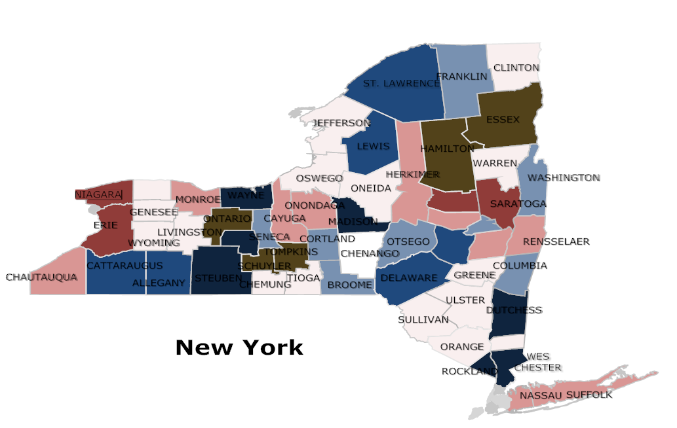
Variation in Indigent Defense Expenditures In Upstate New York
Caseload Adjusted Expenditures 2012
$300 - $400
$400 - $500
$500 - $600
$600 - $700
$700 - $800
$800 - $900
$900 ++

Slide 5
What accounts for variation in indigent defense expenditures?
Analysis of 2012 NY county data suggests that caseloads, county revenue, politics and program type matter in accounting for expenditures per case
Demographic variables play a minor role
Correlates of County Expenditures Per Capita on
Indigent Defense: A Snapshot of 2012
 | B | beta
Criminal caseload per 1000 | .134 | .439***
Family court caseload per 1000 | .111 | .457***
County revenue per capita | .003 | .225*
Residents’ economic well-being | .644 | .160
Median private attorney income | .000 | .140
Rural score (RUCC) | 1.689 | .177
Political conservatism | -.089 | - .217*
% caseload in assigned counsel | .044 | .319***
Constant | - .968 | r2=.539

Slide 6
How has indigent defense funding changed in upstate New York counties between 2002 and 2012?
Expenditures per capita Min Max Median Mean
2002 3.01 20.50 8.73 9.02
2004 5.32 25.98 12.71 12.84
2006 5.41 19.97 11.80 11.86
2008 4.36 24.68 12.00 12.33
2010 5.55 27.31 13.44 13.83
2012 5.76 24.45 13.74 14.08
n=57; all figures are adjusted to 2012 dollars

Slide 7
What might account for variation in counties’ capacity to maintain levels of public defense funding?
Variables that don’t change: demographics, geography, culture, political ideology and social values
Variables that do change: county revenue, caseloads, competing demands for county funds
Historical landmarks that redefine indigent defense: state legislative changes, state administrative oversight, and judicial policy making

Slide 8
Correlates of expenditures per capita, 2002-2012:
2002 2004 2006 2008 2010 2012
Criminal caseload per 1000 pop ++ ++ ++ ++ ++ ++
Family court caseload per 1000 pop 0 0 0 0 0 0
County revenue per capita 0 0 0 ++ ++ ++
Unemployment rate 0 0 0 0 0 0
Social services expenditures per capita ++ ++ ++ ++ ++ ++
Rural score (RUCC) 0 0 0 ++ ++ ++
Political conservatism 0 0 0 0 0 0
Primary: assigned counsel 0 0 0 0 0 0

Slide 9
Are there patterns over time in correlates of expenditures?
Criminal intakes (arrests per capita) are associated with expenditure levels at all points in time – probably because the rate of indigency in criminal cases is fairly constant over time and space
Less is known about the rate of indigency in Family Court filings
Social services expenditures per capita track public defense expenditures per capita – both are redistributive policies involving entitlements
County tax revenues per capita are (positively) correlated with expenditures per capita only after the economy declines
Rural counties spend more on defense only after the economy declines – a possible interpretation is that rural counties’ costs in providing services are less easily trimmed when funds are scarce

Slide 10
A closer look at three time periods:
2002-2006: mixed prosperity across upstate New York
2006-2008: prelude to the Recession
2008-2012: economic decline in the upstate counties
And a closer look at contemporaneous policy changes:
2004: legislatively mandated increase in assigned counsel programs’ reimbursement/fees
2005: New York state begins supplements to county indigent defense budgets with condition of no supplantation and requirement of ‘maintenance of effort’
2007: Hurrell-Harring et al. vs. State of New York et al. filed, challenging state and county structuring and funding of indigent defense
2010: NYS Office of Indigent Legal Services established to oversee allocations of state funding for defense services to counties; suspension of ‘maintenance of effort’ requirement attached to receipt of ILSF grants

Slide 11
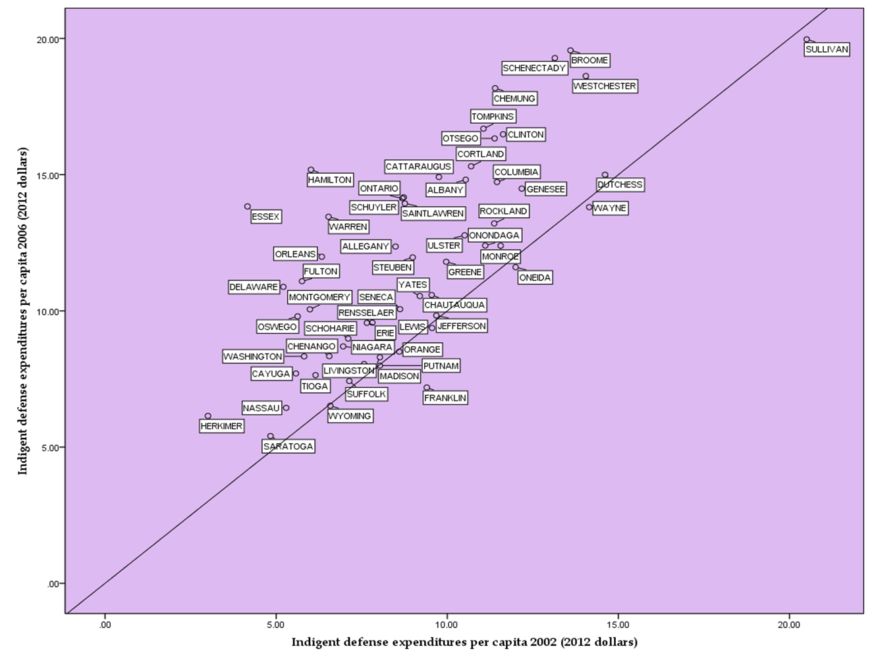
Changes in expenditures per capita 2002-2006:
Most counties increased funding (in real dollars)
But disparities increased somewhat as well
Expenditures changed most dramatically for counties that relied primarily on assigned counsel: 89% on average between 2002 and 2006
Most of this change attributable to 2004 legislative increase in assigned counsel fees

Slide 12
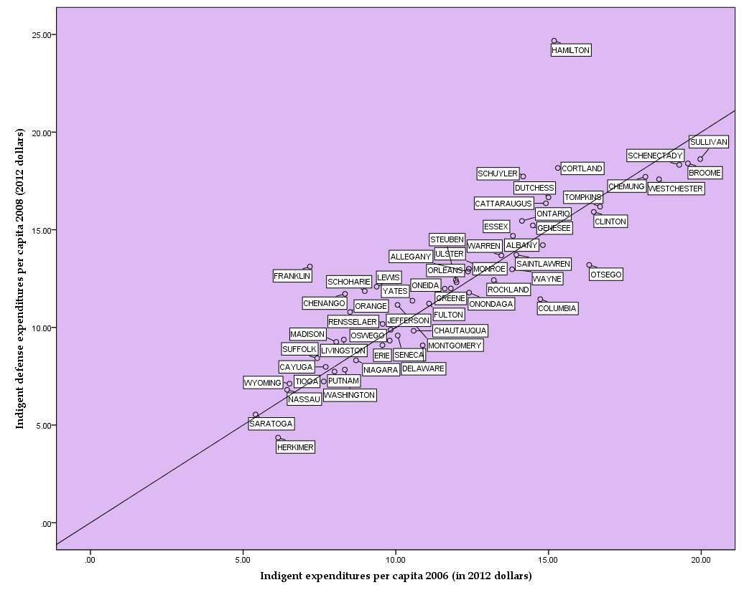
Changes in expenditures per capita 2006-2008
24 of 57 counties spent less per capita after the onset of the recession
Disparities remained: outlays ranged from $5 to $20 per capita
Increases in counties’ family court caseloads associated with increases in expenditures
Counties that relied on assigned counsel reduced expenditures the most
Legislative MOE resulted in stable or increasing budgets, but adjusted expenditures paint a different picture

Slide 13
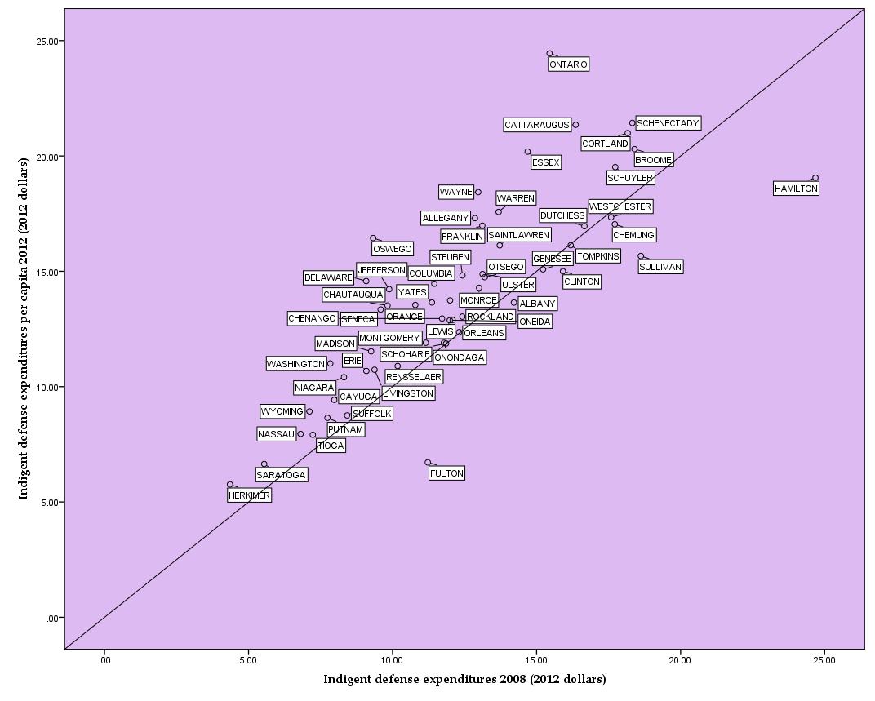
Changes in expenditures per capita 2008-2012
The recession hit upstate New York late: after 2008, mean unemployment rose from 5.7 to 8.5%, county revenue stagnated, and family court caseloads increased
Counties with higher overall expenditures stagnated
Counties that relied on assigned counsel increased expenditures
Counties with larger social services outlays also spent more on indigent defense
Some, but not all, counties named in lawsuit increased expenditures

Slide 14
Summary
Before the Recession, legislative efforts to improve funding through assigned counsel fee increases were successful in the short run
The state’s Maintenance of Effort policy helped to sustain these gains
However, in some counties these gains were lost at the onset of the Recession
In real dollars, budgets have stagnated or fallen in many counties since 2008
Meanwhile Family Court indigent caseloads have increased disproportionately
Wide disparities in indigent defense budgets persisted through the Recession
Continued reliance on county revenues to fund public defense puts defendants and defenders at risk in unstable economic times

Slide 15
Next steps
Data: develop measures or proxies of caseload data that approximate defenders’ experiences
Longitudinal analysis: track simultaneous changes in county revenues, competing demands, changes in program structure with expenditures
Replicate in additional states that rely on county funding
Compare experience with states that rely on legislative appropriations for public defense

